Slide 1
A Machine Learning-Based Groundwater Level Predictor for Sustainable Water Management
CSE7101- Capstone Project
Batch Number: PSCS_327
Under the Supervision of,
Dr. Yamanappa
Assistant Professor
School of Computer Science and Engineering
Presidency University
Roll Number | Student Name
20221CSD0134 20221CSD0117 20221CSD0133 | Chirag K S Shreyas V Arjun Athrey
Name of the Program: B.Tech
Name of the HoD: Dr. Pravinthraja S
Name of the Program Project Coordinator: Dr. H M Manjula
Name of the School Project Coordinators: Dr. Sampath A K , Dr. Geetha A

Slide 2
Problem Statement Number: PSCS 327
Organization:Ministry of Jal Shakti
Category (Hardware / Software / Both) :Software
Problem Description: Groundwater Level is the cardinal parameter that best describes the health of an Aquifer. Long term groundwater level data acquired through regular monitoring of groundwater levels provide an opportunity to understand the behavior of the aquifers to changing stress regime. Central Ground Water Board periodically monitors ground water levels from nearly 26000 wells. CGWB is also in the process of installing Digital Water Level Recorders (DWLRs) across various parts of India Each capturing and transmitting water level data four times per day. In addition to CGWB there are many other agencies measuring water levels. The software application is expected to analyse groundwater levels and factors impacting groundwater level like rainfall, hydrogeology, land use, population, surface elevation, natural features, tidal cycles etc. Based on these factors and based on observed water level data, the software application should be able to predict and forecast groundwater levels both in space and time. The application will be accessible to all for predicting groundwater level at any place at any point on time. This will also help in filling data gaps in time-series data.

Slide 3
Content
Framing the Crisis
Knowledge Foundation
End-to-End Methodology
Results & Insights
Dashboard & Real-World Use
Limitations & Roadmap

Slide 4
Framing the Crisis

Slide 5
Introduction
Groundwater Importance
Need for Prediction
Groundwater serves as Karnataka's primary water source, crucial for both agriculture and drinking. However, rapid depletion due to over-extraction and climate variability poses significant challenges.
Current manual monitoring is slow and sparse, lacking forecasting tools. This project aims to build an ML model and dashboard to predict groundwater levels, supporting sustainable management.

Slide 6
2. Knowledge Foundation

Slide 7
Problem Statement
Manual Monitoring Limitations: Manual groundwater monitoring is slow and sparse, failing to provide timely data. This hampers effective management and planning.
Lack of Forecasting Tools:No forecasting tools are available for districts or taluks, leaving policymakers and farmers unable to anticipate groundwater shortages.
Challenge:The challenge is to build an accurate, usable prediction system based on real data to address these limitations and support sustainable water management.

Slide 8
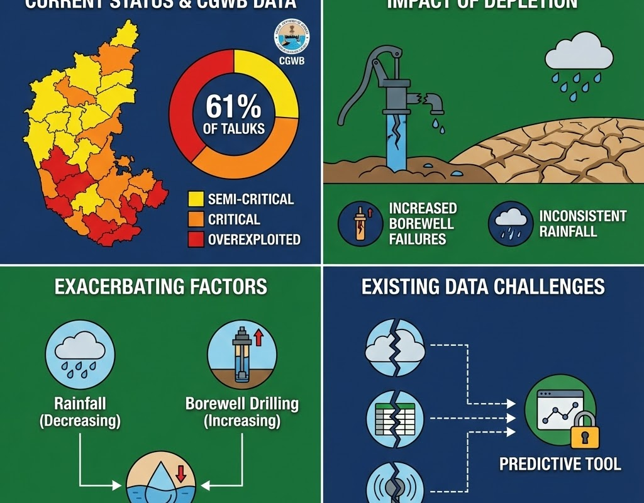
Background
Current Groundwater Status:61% of Karnataka taluks are in semi-critical, critical, or overexploited categories, as reported by the Central Ground Water Board (CGWB).
Impact of Depletion:Increased borewell failures and inconsistent rainfall exacerbate the problem. Existing data sources are not integrated into a usable predictive tool, hindering effective management.

Slide 9
3. End-to-End Methodology

Slide 10
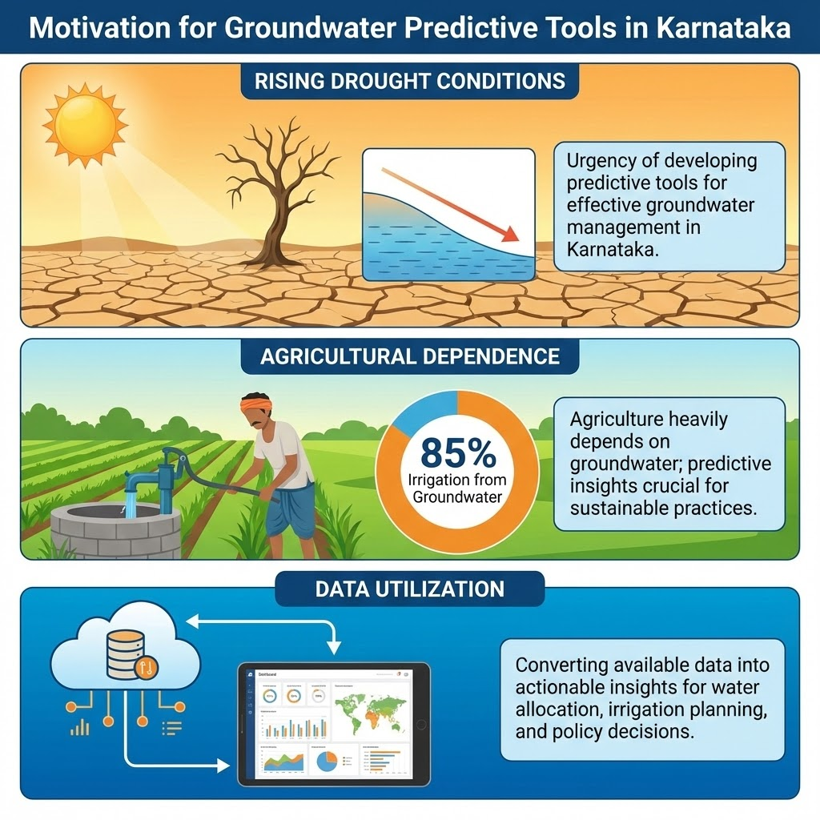
Motivation
Rising Drought Conditions:Rising drought-like conditions in Karnataka highlight the urgency of developing predictive tools to manage groundwater resources effectively.
Agricultural Dependence:Agriculture in Karnataka heavily depends on groundwater, with 85% of irrigation relying on it. Predictive insights are crucial for sustainable practices.
Data Utilization:Despite available data, it is not converted into actionable insights. A predictive tool can guide water allocation, irrigation planning, and policy decisions.

Slide 11
Project Objectives
Data Collection and Cleaning:Collect and clean groundwater, rainfall, and demographic datasets from various sources to create a unified, reliable dataset.
Feature Engineering:Engineer meaningful features that influence groundwater levels, including interactions between rainfall, temperature, and population density.
Model Training:Train machine learning models, primarily using Random Forest, to achieve high accuracy and interpretability in groundwater level predictions.
Dashboard Development:Build an interactive Streamlit dashboard to provide real-time predictions and visual insights for stakeholders.

Slide 12
Scope of Project
Included
Excluded
The project includes Karnataka district/block-level groundwater prediction using ML models and an interactive dashboard with maps, graphs, and predictions.
Excluded from the scope are real-time IoT sensors, borewell-level micro predictions, and long-term climate forecasting.

Slide 13
Literature Review Summary
Prior Models:Prior models have used ANN, SVM, LSTM, and RF. Ensemble methods like Random Forest and XGBoost outperform classical statistical models.
Gaps Identified:Gaps in prior research include the lack of user-friendly dashboards, limited spatial prediction, and missing interaction features like rainfall × temperature × population.
Our Contribution:Our project addresses these gaps by integrating a hybrid ML model with a visualization system for comprehensive groundwater level prediction.

Slide 14
4. Results & Insights

Slide 15
Proposed System
Hybrid ML + Visualization: The proposed system combines machine learning for groundwater level prediction with a visualization interface for easy interpretation.
Spatial Heatmaps: It generates spatial heatmaps to visualize the distribution of predicted groundwater levels across regions.
Prediction Capabilities:The system predicts groundwater levels in meters below ground level, providing actionable insights for water management.
Scenario Analysis: Users can run scenario analysis ('what-if' simulations) to explore the impact of different conditions on groundwater levels.

Slide 16
System Architecture
Data Flow
Block Diagram
Data flows from sources like CGWB, IMD, KGWA, and India-WRIS through preprocessing, feature engineering, model training, evaluation, and finally to the Streamlit dashboard for predictions.
A simple block diagram illustrates the architecture, highlighting key components and their interactions in the system.

Slide 17
Methodology
V-Model Approach: The project follows a V-Model development approach, ensuring a structured and systematic process from requirements to deployment.
Development Steps: Steps include requirement analysis, design (architecture and flow), implementation (ML model and dashboard), testing (unit, system, user), and deployment.
Quality Assurance: Rigorous testing ensures the system's reliability and usability, with user acceptance testing validating its effectiveness.

Slide 18
5. Dashboard & Real-World Use

Slide 19
Dataset Sources
CGWB Data:Groundwater levels are sourced from the Central Ground Water Board (CGWB) for accurate depth measurements.
KGWA Data: Local borewell statistics are provided by the Karnataka Ground Water Authority (KGWA) for regional insights.
India-WRIS Data: Mapping and geo-data are sourced from India-WRIS to integrate spatial elements into the dataset.
IMD Data: Rainfall and temperature data are obtained from the India Meteorological Department (IMD) for meteorological context.

Slide 20
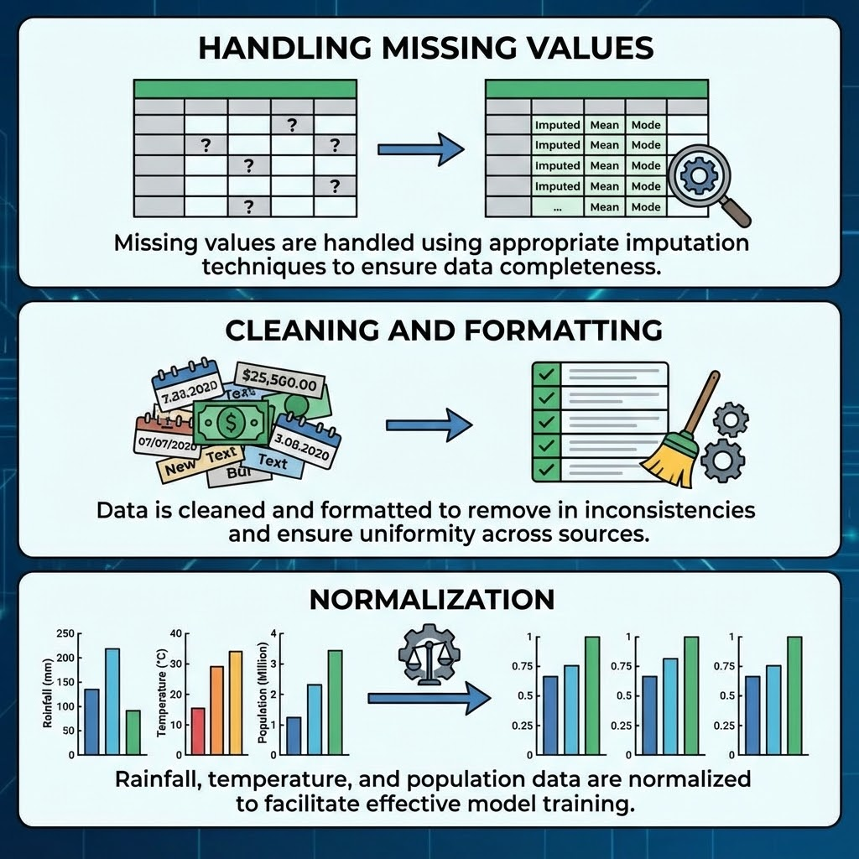
Data Preprocessing
Handling Missing Values Missing values are handled using appropriate imputation techniques to ensure data completeness.
Cleaning and Formatting: Data is cleaned and formatted to remove inconsistencies and ensure uniformity across sources.
Normalization: Rainfall, temperature, and population data are normalized to facilitate effective model training.

Slide 21
Feature Engineering
Interaction Features:Interaction features like rainfall × temperature are engineered to capture complex relationships influencing groundwater levels.
Population Density: Population density is included as a feature to reflect the impact of human activity on groundwater resources.
Soil-Type Features: Soil-type categorical features are encoded to account for the influence of soil properties on groundwater recharge.
Regional Grouping: Regional grouping and yearly trends are used to capture spatial and temporal variations in groundwater levels.

Slide 22
6. Limitations & Roadmap

Slide 23
Machine Learning Models
Comparison Model: XGBoost is used as a comparison model to evaluate performance and select the best approach.
Advantages of Random Forest:Random Forest handles nonlinear patterns, is robust to missing and noisy data, and provides high accuracy and interpretability.
Primary Model: The primary model used is the Random Forest Regressor for its robustness and interpretability.

Slide 24
Model Training
Train-Test Split:Data is split into training (80%) and testing (20%) sets to evaluate model performance.
Evaluation Metrics:Model performance is evaluated using RMSE, MAE, and R² metrics to ensure reliability.
Hyperparameter Tuning:Hyperparameter tuning is performed to optimize model parameters for better accuracy.
Model Storage: The trained model is stored as a .pkl file for integration with the dashboard.

Slide 25
Performance Results
Comparison with XGBoost
Random Forest Performance
Random Forest outperformed XGBoost in consistency, providing stable predictions suitable for groundwater level forecasting.
The Random Forest model achieved a high R² score of approximately 0.89, indicating strong predictive accuracy.

Slide 26
Feature Importance Analysis
Key Factors: Rainfall, temperature, soil type, and population density are identified as key factors influencing groundwater levels.
Temperature Influence: Higher temperatures are associated with deeper groundwater levels, indicating evaporation effects.
Rainfall Impact: Rainfall is the strongest recharge driver, significantly impacting groundwater levels.
Visualization: Feature importance is visualized using the model's feature importances to provide clear insights.

Slide 27
Dashboard Overview
Built with Streamlit and Plotly: The interactive dashboard is built using Streamlit and Plotly for a user-friendly interface.
Features: Users can select parameters, view real-time predictions, compare actual vs predicted values, and access charts and metric outputs.
Actionable Insights: The dashboard provides actionable insights for stakeholders to make informed decisions on groundwater management.

Slide 28
Prediction Module Demo
User Inputs: Users can input soil type, rainfall, temperature, population, and coordinates into the dashboard.
Output: The dashboard outputs the predicted groundwater level along with a visualization for easy interpretation.
Real-Time Prediction: Real-time prediction capabilities allow users to forecast groundwater levels based on current conditions.
Visualization: Visualizations enhance understanding, making it easier for stakeholders to grasp groundwater level trends.

Slide 29
Heatmap Visualization
Spatial Distribution: The heatmap visualizes the spatial distribution of predicted groundwater levels across regions.
Regional Insights: It highlights low-level and high-level regions, providing valuable insights for government and planning committees.
Screenshot: A screenshot of the heatmap is included to demonstrate the visualization capabilities of the dashboard.

Slide 30
Insights & Interpretation
Rainfall Recharge: Rainfall continues to be the strongest recharge driver, highlighting its critical role in groundwater replenishment.
Population Impact: Human density negatively correlates with water table height, reflecting the strain of population on groundwater resources.
Temperature Effects: High-temperature zones show deeper groundwater levels, indicating the impact of evaporation and water loss.
Soil Type Influence:Soil type significantly impacts recharge capability, emphasizing the importance of soil properties in groundwater management.

Slide 31
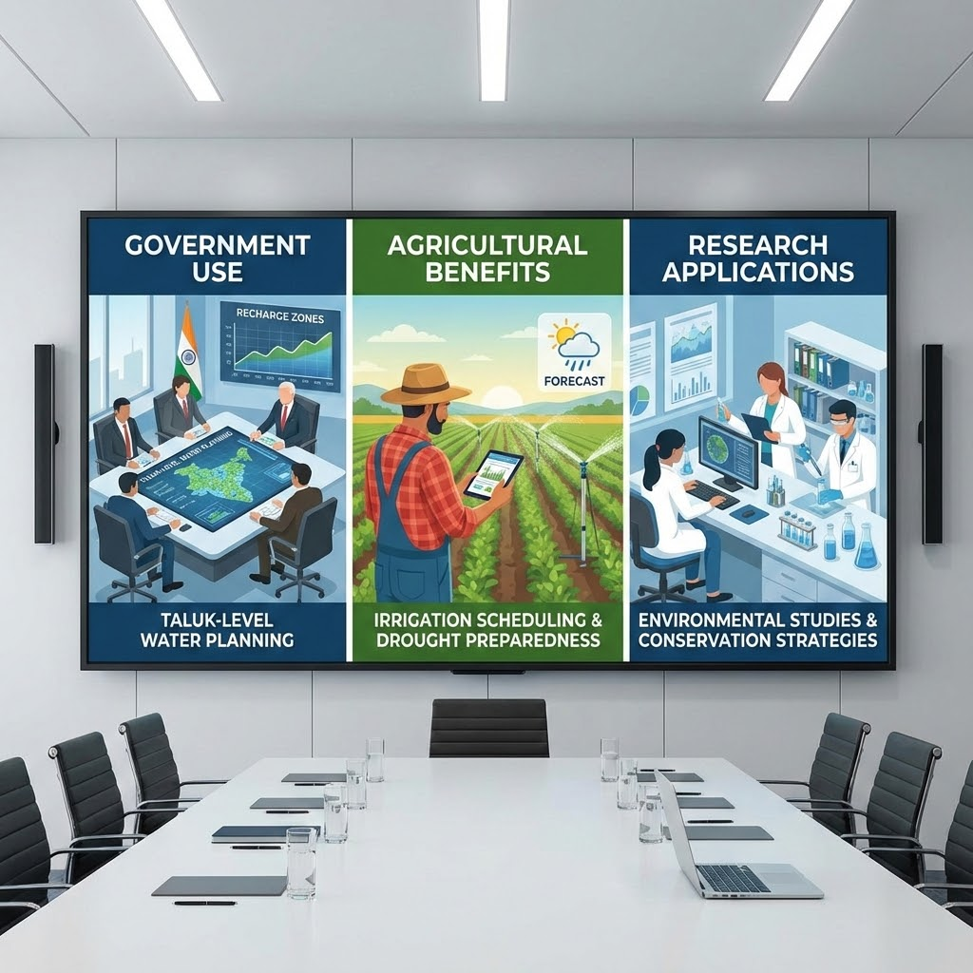
Applications
Government Use: The system supports taluk-level water planning, recharge zone identification, and evidence-based policy decisions for sustainable water management.
Agricultural Benefits: Farmers can use the system for irrigation scheduling and drought preparedness, optimizing water use and crop yields.
Research Applications: Researchers can leverage the system for environmental studies and developing water conservation strategies.

Slide 32
Limitations
Data Timeliness: The dataset is not real-time, relying on annual updates which may limit immediate response capabilities.
Climate Integration: The model lacks integration with long-term climate projections, limiting its scope for future planning.
Prediction Granularity: Predictions are not specific to individual borewells, focusing on district/taluk levels instead.
Data Quality Dependency: Model performance depends on the quality of data from external sources, which may introduce inaccuracies.

Slide 33
Conclusion & Future Scope
Conclusion
Future Scope
The project successfully developed a reliable groundwater prediction model integrated into an interactive dashboard, providing actionable insights for sustainable water management.
Future work includes IoT sensor integration for real-time updates, LSTM time-series predictions, mobile app integration, and statewide deployment as an API.

Slide 34
Github Link
A public GitHub repository will be maintained.
Link: GitHub Link

Slide 35


